Slide 1
SS ZG 526: Distributed Computing
Distributed Communication Models
Chittaranjan Hota
Professor, Dept. of Computer Sc. & Information Systems
BITS, Pilani Hyderabad Campus, Hyderabad
hota@hyderabad.bits-pilani.ac.in

Slide 2

RPC: Remote Procedure Call
Issues:
  identifying and accessing the remote procedure
  parameters
  return value
Sun RPC
Microsoft’s DCOM
OMG’s CORBA
Java RMI
XML/RPC
SOAP/.NET
AJAX (Asynchronous Javascript and XML)
Birla Institute of Technology and Science, Pilani (Deemed University)

Slide 3
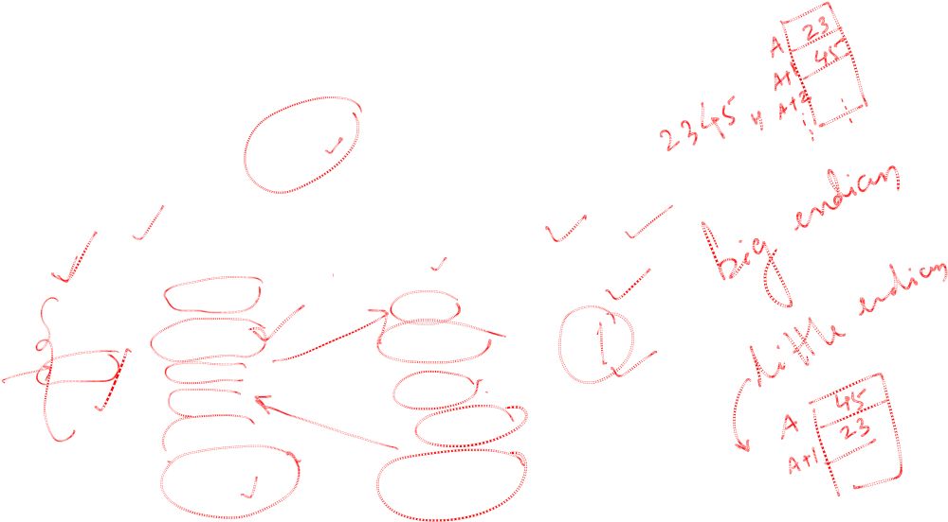
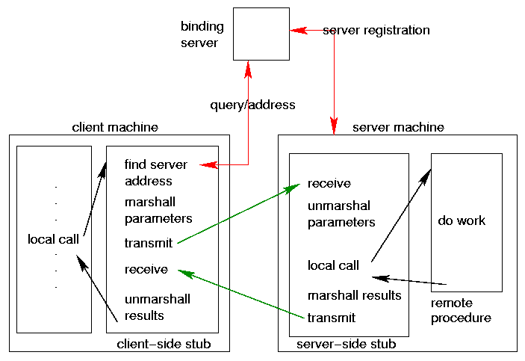
Remote Procedure Calls (RPC)
Birla Institute of Technology and Science, Pilani (Deemed University)

Slide 4

Procedure arguments
To reduce the complexity of the interface specification, Sun RPC includes support for a single argument to a remote procedure.*
Typically the single argument is a structure that contains a number of values.
*Newer versions can handle multiple arguments.
Birla Institute of Technology and Science, Pilani (Deemed University)

Slide 5

Procedure identification
Each procedure is identified by:
  Hostname (IP Address)
  Program identifier (32 bit integer)
  Procedure identifier (32 bit integer)
  Program Version identifier
    for testing and migration.
Birla Institute of Technology and Science, Pilani (Deemed University)

Slide 6

Program identifiers
Each remote program has a unique ID.
Sun divided up the IDs:
  0x00000000 - 0x1fffffff
  0x20000000 - 0x3fffffff
  0x40000000 - 0x5fffffff
  0x60000000 - 0xffffffff
Sun
SysAdmin
Transient
Reserved
Birla Institute of Technology and Science, Pilani (Deemed University)

Slide 7
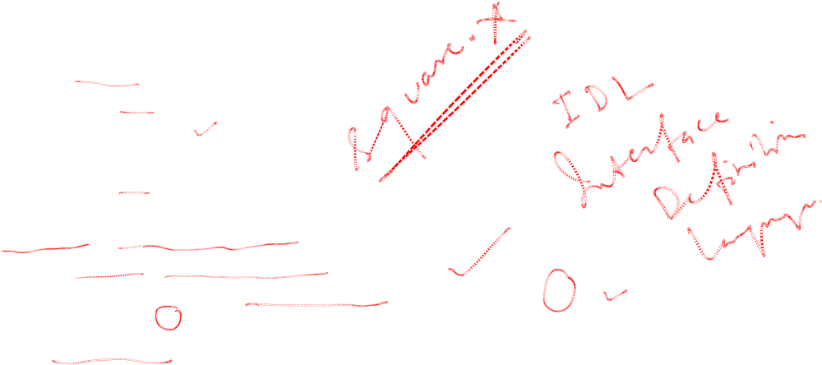
SUN RPC
struct square_in {
long arg1;
};
struct square_out {
long res1;
};
program SQUARE_PROG {
version SQUARE_VERS {
square_out SQUAREPROC(square_in) = 1;
} = 1;
} = 0x13451111;
Birla Institute of Technology and Science, Pilani (Deemed University)

Slide 8

Rpcgen
Protocol
Description
Input File
rpcgen
Client Stubs
XDR filters
header file
Server skeleton
C Source Code
Birla Institute of Technology and Science, Pilani (Deemed University)

Slide 9

Rpcgen continued…
bash$ rpcgen square.x
produces:
  square.h header
  square_svc.c server stub
  square_clnt.c client stub
  square_xdr.c XDR conversion routines
Function names derived from IDL function names and version numbers
Birla Institute of Technology and Science, Pilani (Deemed University)

Slide 10

Square Client: Client.c
#include “square.h”
#include <stdio.h>
int main (int argc, char **argv)
{ CLIENT *cl;
square_in in;
square_out *out;
if (argc != 3) { printf(“client <localhost> <integer>”); exit (1); }
cl = clnt_create (argv[1], SQUARE_PROG, SQUARE_VERS, “tcp”);
in.arg1 = atol (argv [2]);
if ((out = squareproc_1(&in, cl)) == NULL)
{ printf (“Error”); exit(1); }
printf (“Result %ld\n”, out -> res1);
exit(0);
}
Birla Institute of Technology and Science, Pilani (Deemed University)

Slide 11

Square server: server.c
#include “square.h”
#include <stdio.h>
square_out *squareproc_1_svc (square_in *inp, struct svc_req *rqstp)
{
static square_out *outp;
outp.res1 = inp -> arg1 * inp -> arg1;
return (&outp);
}
Birla Institute of Technology and Science, Pilani (Deemed University)

Slide 12

Exe creation
gcc –o client client.c square_clnt.c square_xdr.c –lnsl
gcc –o server server.c square_svc.c square_xdr.c –lrpcsvc -lnsl
Birla Institute of Technology and Science, Pilani (Deemed University)

Slide 13
Next module
How to model a distributed computation, and logical
clocks?
Birla Institute of Technology and Science, Pilani (Deemed University)

